Slide 1


SageVPN
Created by:
Tucker Cook
Ayush Verma

Slide 2
SageVPN
Purpose: Address increasing security and data privacy concerns in the automotive sector
Goals:
Regulate the data packets sent from vehicles to protect user information
Prevent cases where user data is unfoundedly used against drivers

Slide 3
Team Makeup
Primary Members:
Ayush Verma, vermaa5@mail.uc.edu
Tucker Cook, cook2tc@mail.uc.edu
Project Advisor:
Professor Giovani Abuaitah

Slide 4
Project Goals– Knowledge is Power
All newly manufactured vehicles utilize wireless network connections for various vehicle functionalities. Use of this technology in automotive raises serious concerns for user privacy and security.
Our goal for this project is to develop an application that allows the user to select what information they want sent from their vehicle.

Slide 5
Real-World Examples of What Goes Wrong in Software-Defined Vehicles & Data-Driven Development
Subaru Security Flaws Exposed Its System for Tracking Millions of Cars
Hackers found an exploit in Subaru admin portal to access many pieces of information the vehicle had transmitted back to Subaru including engine start times and every location the vehicle had been to
Hacking Kia: Remotely Controlling Cars With Just a License Plate
Hackers found an exploit to create a dealer account in owners.kia.com and used HTTP requests with vehicle VIN to allow hacker to utilize various vehicle functionalities (start car, open door, etc.) remotely
Two GR Corollas Burned Down. Toyota Won’t Honor the Warranties
Toyota denied warranty of a vehicle which engine caught on fire, on the basis that the vehicle at some point had gone over 85 mph
data leak at the Volkswagen Group: We know where your car is
Precise location data of VW vehicles was publicly accessible through insecure AWS config

Slide 6
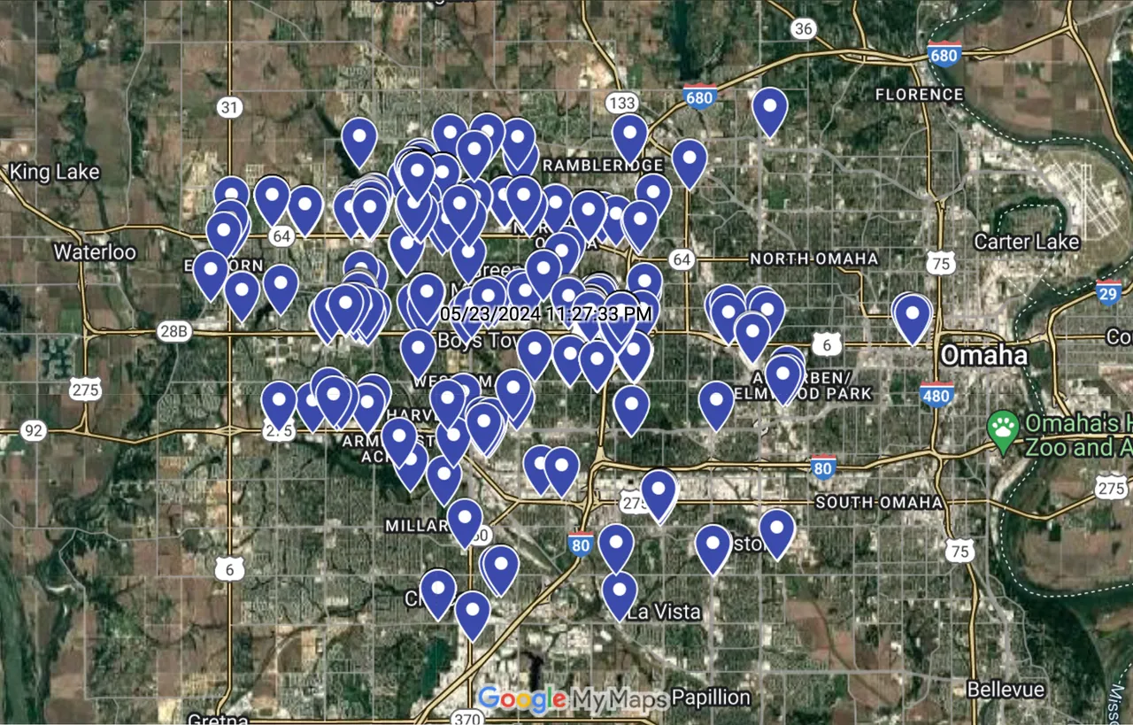
Real-World Examples of What Goes Wrong in Software-Defined Vehicles & Data-Driven Development
Location data of a Subaru Impreza accessed through Subaru admin portal

Slide 7
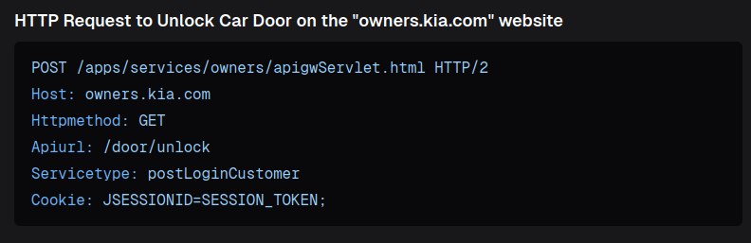
Real-World Examples of What Goes Wrong in Software-Defined Vehicles & Data-Driven Development
HTTP Request to unlock doors, there are various other vehicle functionalities that can be activated via HTTP across many vehicles sold today

Slide 8
Intellectual Merits
We appreciate the benefits of data-driven development to improve the end product; however information sent to OEMs/Insurance should always be voluntary on the user’s behalf.
There are proven examples of OEMs selling user data to 3rd parties such as Verisk (Automakers Sold Drivers' Data for Shockingly Low Amounts of Money)
Thus our application allows users to both visualize and block/intercept vehicle and user data that is transmitted wirelessly to OEM

Slide 9
Broader Impacts
Our application prevents instances where data is unfoundly used against user in warranty claims & insurance claims/rates
–And–
Prevents user data from making its way to a database that is at risk for being improperly managed by OEM
–And–
Disabling entry points for hackers that can use data/vehicle functionality for malicious intents

Slide 10
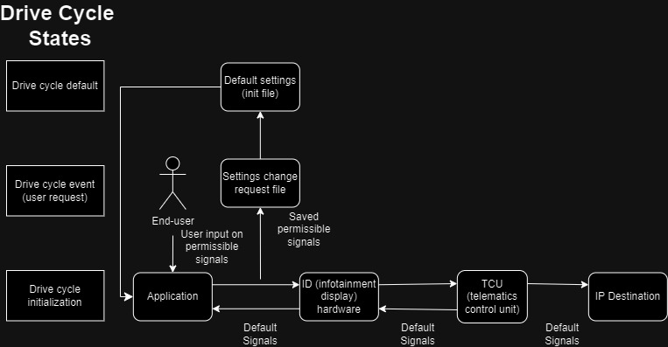
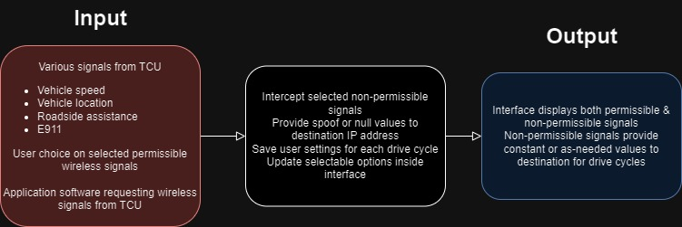
Design Specifications

Slide 11
Technology Used
Various Android development & networking tools (VPN Services)
Kotlin

Slide 12
Milestones
February 28th - Initial VPN connection established
March 7th - Completed UI
March 18th - Network data fully parsed in application
March 30th - Completed Application
April 5th - Expo Poster

Slide 13
Results
Android 4.0 VM setup
General application architectural design created
VPN permissions initialized in Android Project
Remaining work includes creating the rest of the application UI and starting up the actual VPN connection to begin reading network traffic on the android device. The final step from there will be to parse the traffic to display it to the user. Final deliverables will include the completed application, all corresponding documentation, and the expo poster.

Slide 14
Challenges
No prior experience with Android development at all
Dedicated an entire hackathon to immersing ourselves in Android development and the environment to learn enough to eventually build off of for our own project
Old version of Android (4.0) needed for vehicle environment
We’ve had to do a lot of our own investigation into how things work since most current documentation will be too new for our purposes and the devices we need to support
Understanding the information coming from parsed packets
We will be fully leveraging the knowledge we gained from taking networking courses throughout our degrees, as well as relying on our project advisor to help bridge gaps on any areas we still lack in

Slide 15
Challenges (cont.)
Our project necessitates taking advantage of known security vulnerabilities of an existing system, which requires an elevated understanding of subsystems in the vehicle our project is going to interact with. To maintain professional integrity, under no circumstance will our knowledge of how these systems work come from OEM documentation or personnel, and will strictly be limited to our own discovery and learning of these systems such as the ID and TCU. Our project will use openly available information from various sources outside of the vehicle manufacturer to implement our project, this is to show our respect to companies that made the vehicle and our commitment to learn on our own.

Slide 16
Demo!

